Slide 1

YOU BE
THE JUDGE

Slide 2

WHAT IS A
ROLE-PLAY?
A real-world scenario
Based on a possible situation
Usually relevant to current business trends
Includes a problem that needs to be solved or a plan that needs to be prepared
PREP
TIME
PRESENT
TIME
Notes:
Back Cover - $6,000
Inside Front/Back Cover - $5,000
Color - $3,500

Slide 3
ON THE MARK
You are to assume the role of the district talent manager for On the Mark, a discount retailer with more than 2,000 locations nationwide. The district manager (judge) wants you to determine how stores in the district can find and hire their own seasonal employees rather than using the corporate talent website.

Slide 4
PERFORMANCE INDICATORS
Explain the nature of human resources management.
Discuss factors that impact human resources management.
Describe planning techniques used in the hiring process.
Explain assessment method used in the hiring process.
Demonstrate connections between company actions and results.

Slide 5
ON THE MARK
The district manager (judge) wants you to determine how On the Mark stores in the district can host their own in-store events to hire seasonal employees rather than using the corporate talent website. The district manager (judge) wants you to plan in-store hiring events, determine how they will be promoted, what skills will be assessed at the events, how skill assessment will occur and explain how the events will provide better results than the use of the corporate talent website.

Slide 6
PERFORMANCE INDICATORS
Explain the nature of human resources management.
Discuss factors that impact human resources management.
Describe planning techniques used in the hiring process.
Explain assessment method used in the hiring process.
Demonstrate connections between company actions and results.

Slide 7

SCENARIO EXAMPLES
Creating a promotional plan for a new product
Developing a plan to conduct marketing research to solve a problem
Proposing a new target market or channel of distribution
Evaluating the ethical concerns in a given situation
Planning a project and calculating a budget
Hiring, training or terminating an employee
Improving store quality or employee safety
Correcting an issue resulting in a sales loss
Notes:
Back Cover - $6,000
Inside Front/Back Cover - $5,000
Color - $3,500

Slide 8
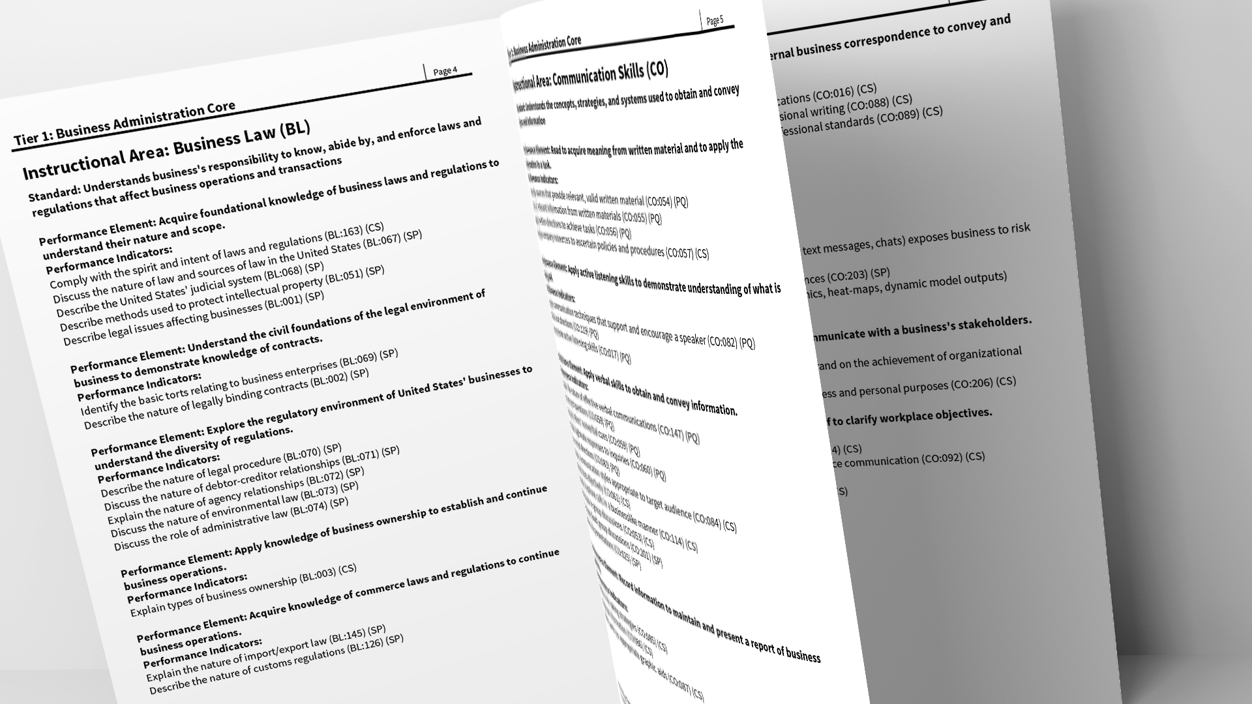
WHAT IS A PERFORMANCE INDICATOR?
Performance Indicators:
Are specific knowledge and skills that students are expected to address and perform through competition.
Represent the current, actual skills and knowledge needed by employees in the workplace. Members who can demonstrate these performance indicators are sought after by employers.
For example, one performance indicator is “Write professional emails.” Employers expect their employees to be able to communicate via e-mail in a professional manner and according to the company’s standards.
Notes:
Back Cover - $6,000
Inside Front/Back Cover - $5,000
Color - $3,500

Slide 9
ROLE-PLAY OVERVIEW
Instructional Area
Prep Time / Present Time
21st Century Skills
Performance Indicators

Slide 10
DURING THE ROLE-PLAY
YOU CAN
Bring a four-function calculator for math.
Take notes to bring with you to see the judge.
Make materials appropriate to the role-play to hand to the judge.
Use your creativity and innovative thinking!
Practice, practice, practice, and develop a strategy to tackle the role-play. HINT: The format of the role-play is consistent; usually, prep and present time is too – practice to plan accordingly.
YOU CANNOT
Bring in materials with you for prep time.
Bring in your own pens, markers or colored paper.
Take the actual role-play with you to see the judge.
Use additional resources, including electronics. Also, no photos!
Ask the judge for feedback regarding your performance at the conclusion of the role-play.
Take your notes when you leave once you see the judge.

Slide 11
ROLE-PLAY OVERVIEW
Student Role
Company
Judge Role
Deliverable
Meeting Location
Notes:
Back Cover - $6,000
Inside Front/Back Cover - $5,000
Color - $3,500

Slide 12
ROLE-PLAY OVERVIEW
Instructional Area
Performance Indicators
21st Century Skills
Notes:
Back Cover - $6,000
Inside Front/Back Cover - $5,000
Color - $3,500

Slide 13
EVALUATION

Slide 14
EXPLAIN THE PERFORMANCE INDICATORS
AS THEY RELATE TO YOUR SOLUTION
PERFORMANCE INDICATORS ALONE WILL NOT SOLVE THE PROBLEM

Slide 15
AN EXAMPLE
EXPLAIN THE IMPORTANCE OF MEETING AND EXCEEDING CUSTOMER/GUEST EXPECTATIONS.
When a company meets and exceeds customer expectations it differentiates itself from the competition. It also creates customer loyalty and high chances of positive reviews and word-of-mouth marketing from the customer base. If customer expectations are not met, customers are not likely to return and will tell others about their experience.
Therefore, at Shore Line Inn, it is extremely important as an independent hotel property to exceed our guests’ expectations not only so they will return as repeat customers, but also so they can spread positive word of mouth reviews to potential guests. We must take this into high consideration when determining how to reward our loyal guests.

Slide 16

LET’S GO!
PERFORMANCE INDICATORS ALONE WILL NOT SOLVE THE PROBLEM

Slide 17
PERFORMANCE INDICATORS
The owner (judge) has asked you to recommend innovative guest benefits to offer to loyal customers that will reward them for their continued business.
Describe services offered by the hospitality and tourism industry.
Establish relationship with hospitality and tourism customer/guest.
Identify factors that influence guest experiences throughout the guest life cycle.
Discuss actions employees can take to achieve the company’s desired results.
Demonstrate connections between company actions and results.

Slide 18
USE VISUAL AIDS (NOT NOTES)
IDEAS FOR VISUAL AIDS
Goals and Objectives
Theme or Slogan
Store Layouts
Diagrams or Visual Organizers
Benefits/Advantages
Challenges/Disadvantages
SWOT Analysis
Costs and Expenses
Budget Sheet
Pie Charts and Graphs
A Calendar or Timeline
Brochures or Employee Training Manuals
Contract
Advertisements (Banners, TV, Social Media)
Social Media Posts

Slide 19
BONUS IDEAS
Remember to demonstrate the 21st Century Skills — smile, eye contact, confidence, creativity, communication skills
Demonstrate creativity — your judge may hear up to 20 ideas in a day. What will make you stand out?
Use visual aids (not notes).
Go above and beyond —additional value you provide in your solution
Close strong — have a specific call to action or follow-up item to close the role-play.

Slide 20
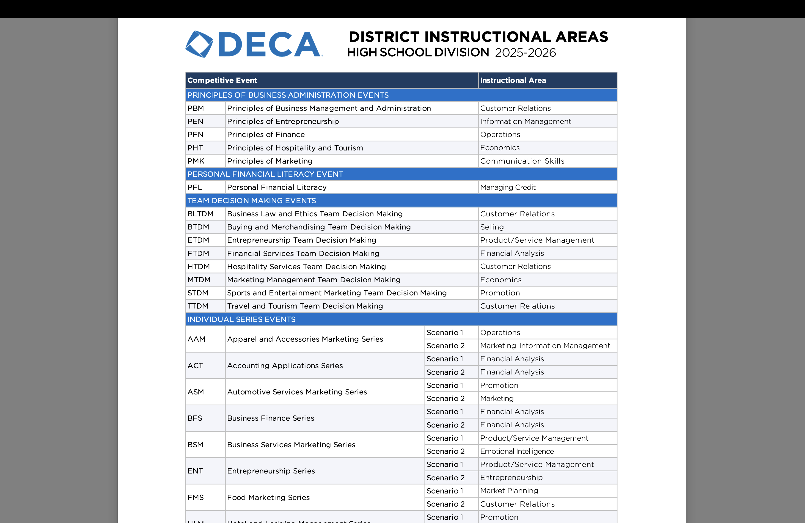
DISTRICT INSTRUCTIONAL AREAS

Slide 21
PERFORMANCE INDICATORS
 | Participant | Prep | Presentation | Performance Indicators
Principles Events | 1 | 10 minutes | 10 minutes | 4
Individual Series Events | 1 | 10 minutes | 10 minutes | 5
Team Decision Making Events | 2 | 30 minutes | 15 minutes | 7
Personal Financial Literacy | 1 | 10 minutes | 10 minutes | 3
Notes:
Each role-play and case study supports a specific career cluster and primary instructional area that is identified at the top of the first page of the event. DECA’s role-plays and case studies are developed through industry research to reflect current issues and trends in business and industry. The role-play and case study scenarios are connected to performance indicators. DECA members are challenged to develop a solution that incorporates the performance indicators relevant to the specific role-play or case study, while demonstrating 21st Century Skills. Individual Series Events are also connected to a specific career pathway.

Slide 22
DEMONSTRATION OF PIS
  Retail Merchandising Series Event:
  Promotional strategy for back-to-school items
  Where can performance indicators come from?
    Need Five Performance Indicators
      At least 3 from one Instructional Area (*In this example: Promotion instructional area)
      At least 1 from Merchandising Pathway (*because it is a Retail Merchandising Event)
      None from other pathways (*because Retail Merchandising ONLY uses merchandising pathway)
Notes:
Each role-play and case study supports a specific career cluster and primary instructional area that is identified at the top of the first page of the event. DECA’s role-plays and case studies are developed through industry research to reflect current issues and trends in business and industry. The role-play and case study scenarios are connected to performance indicators. DECA members are challenged to develop a solution that incorporates the performance indicators relevant to the specific role-play or case study, while demonstrating 21st Century Skills. Individual Series Events are also connected to a specific career pathway.

Slide 23
Varying Instructional Areas
No repeated instructional area in a competitive year
Exceptions: Finance, HR, Entrepreneurship, Marketing Communications
Apparel and Accessories Marketing
  District 1: Product/Service Management Market Planning
  District 2: Operations Customer Relations
  Association 1: Market Planning Marketing-Info Management
  Association 2: Economics Promotion
  ICDC 1: Selling Marketing
  ICDC 2: Marketing Selling
  ICDC Final: Customer Relations Product/Service Management

Slide 24
Progression of difficulty
DISTRICT
ASSOCIATION
more challenging, management situation
ICDC
upper-level management situation
customer service dilemma, everyday situation

Slide 25
WHERE DO SCENARIO IDEAS COME FROM?
NRF smart brief emails (retail, HR, food marketing, ENT, tech, International, etc.)
Daily briefs from national news sources (USA Today, New York Times, Washington Post, AdWeek, inc., etc.)
Submissions from business partners/past judges
Real-life experiences

Slide 26
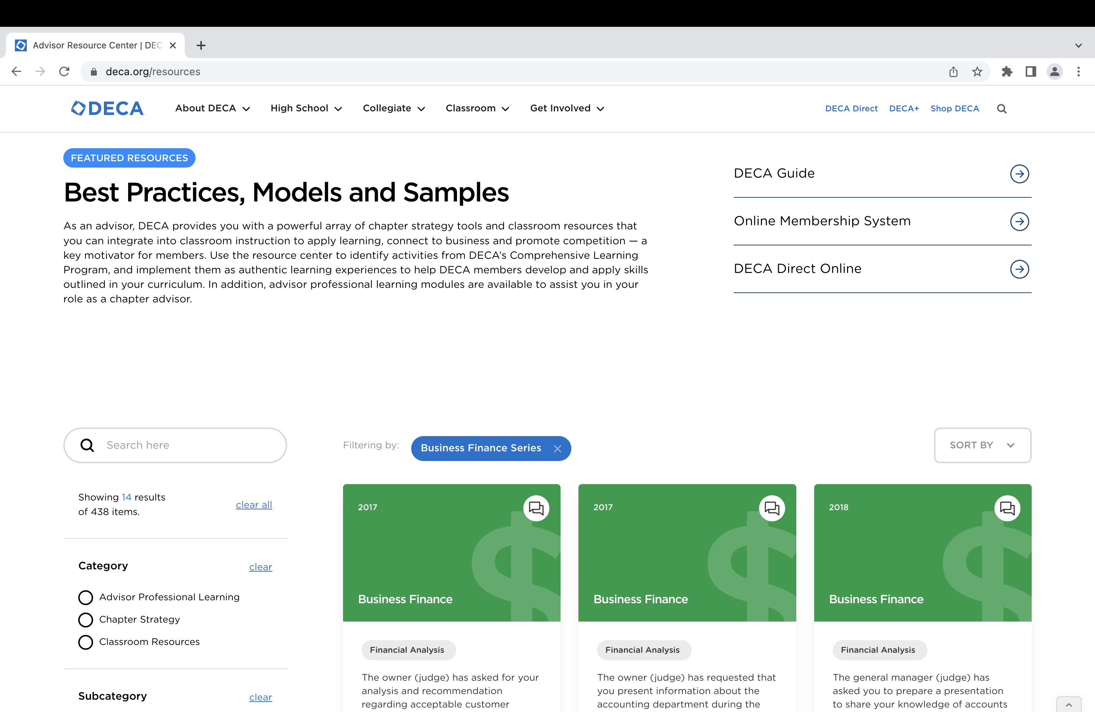

Slide 27
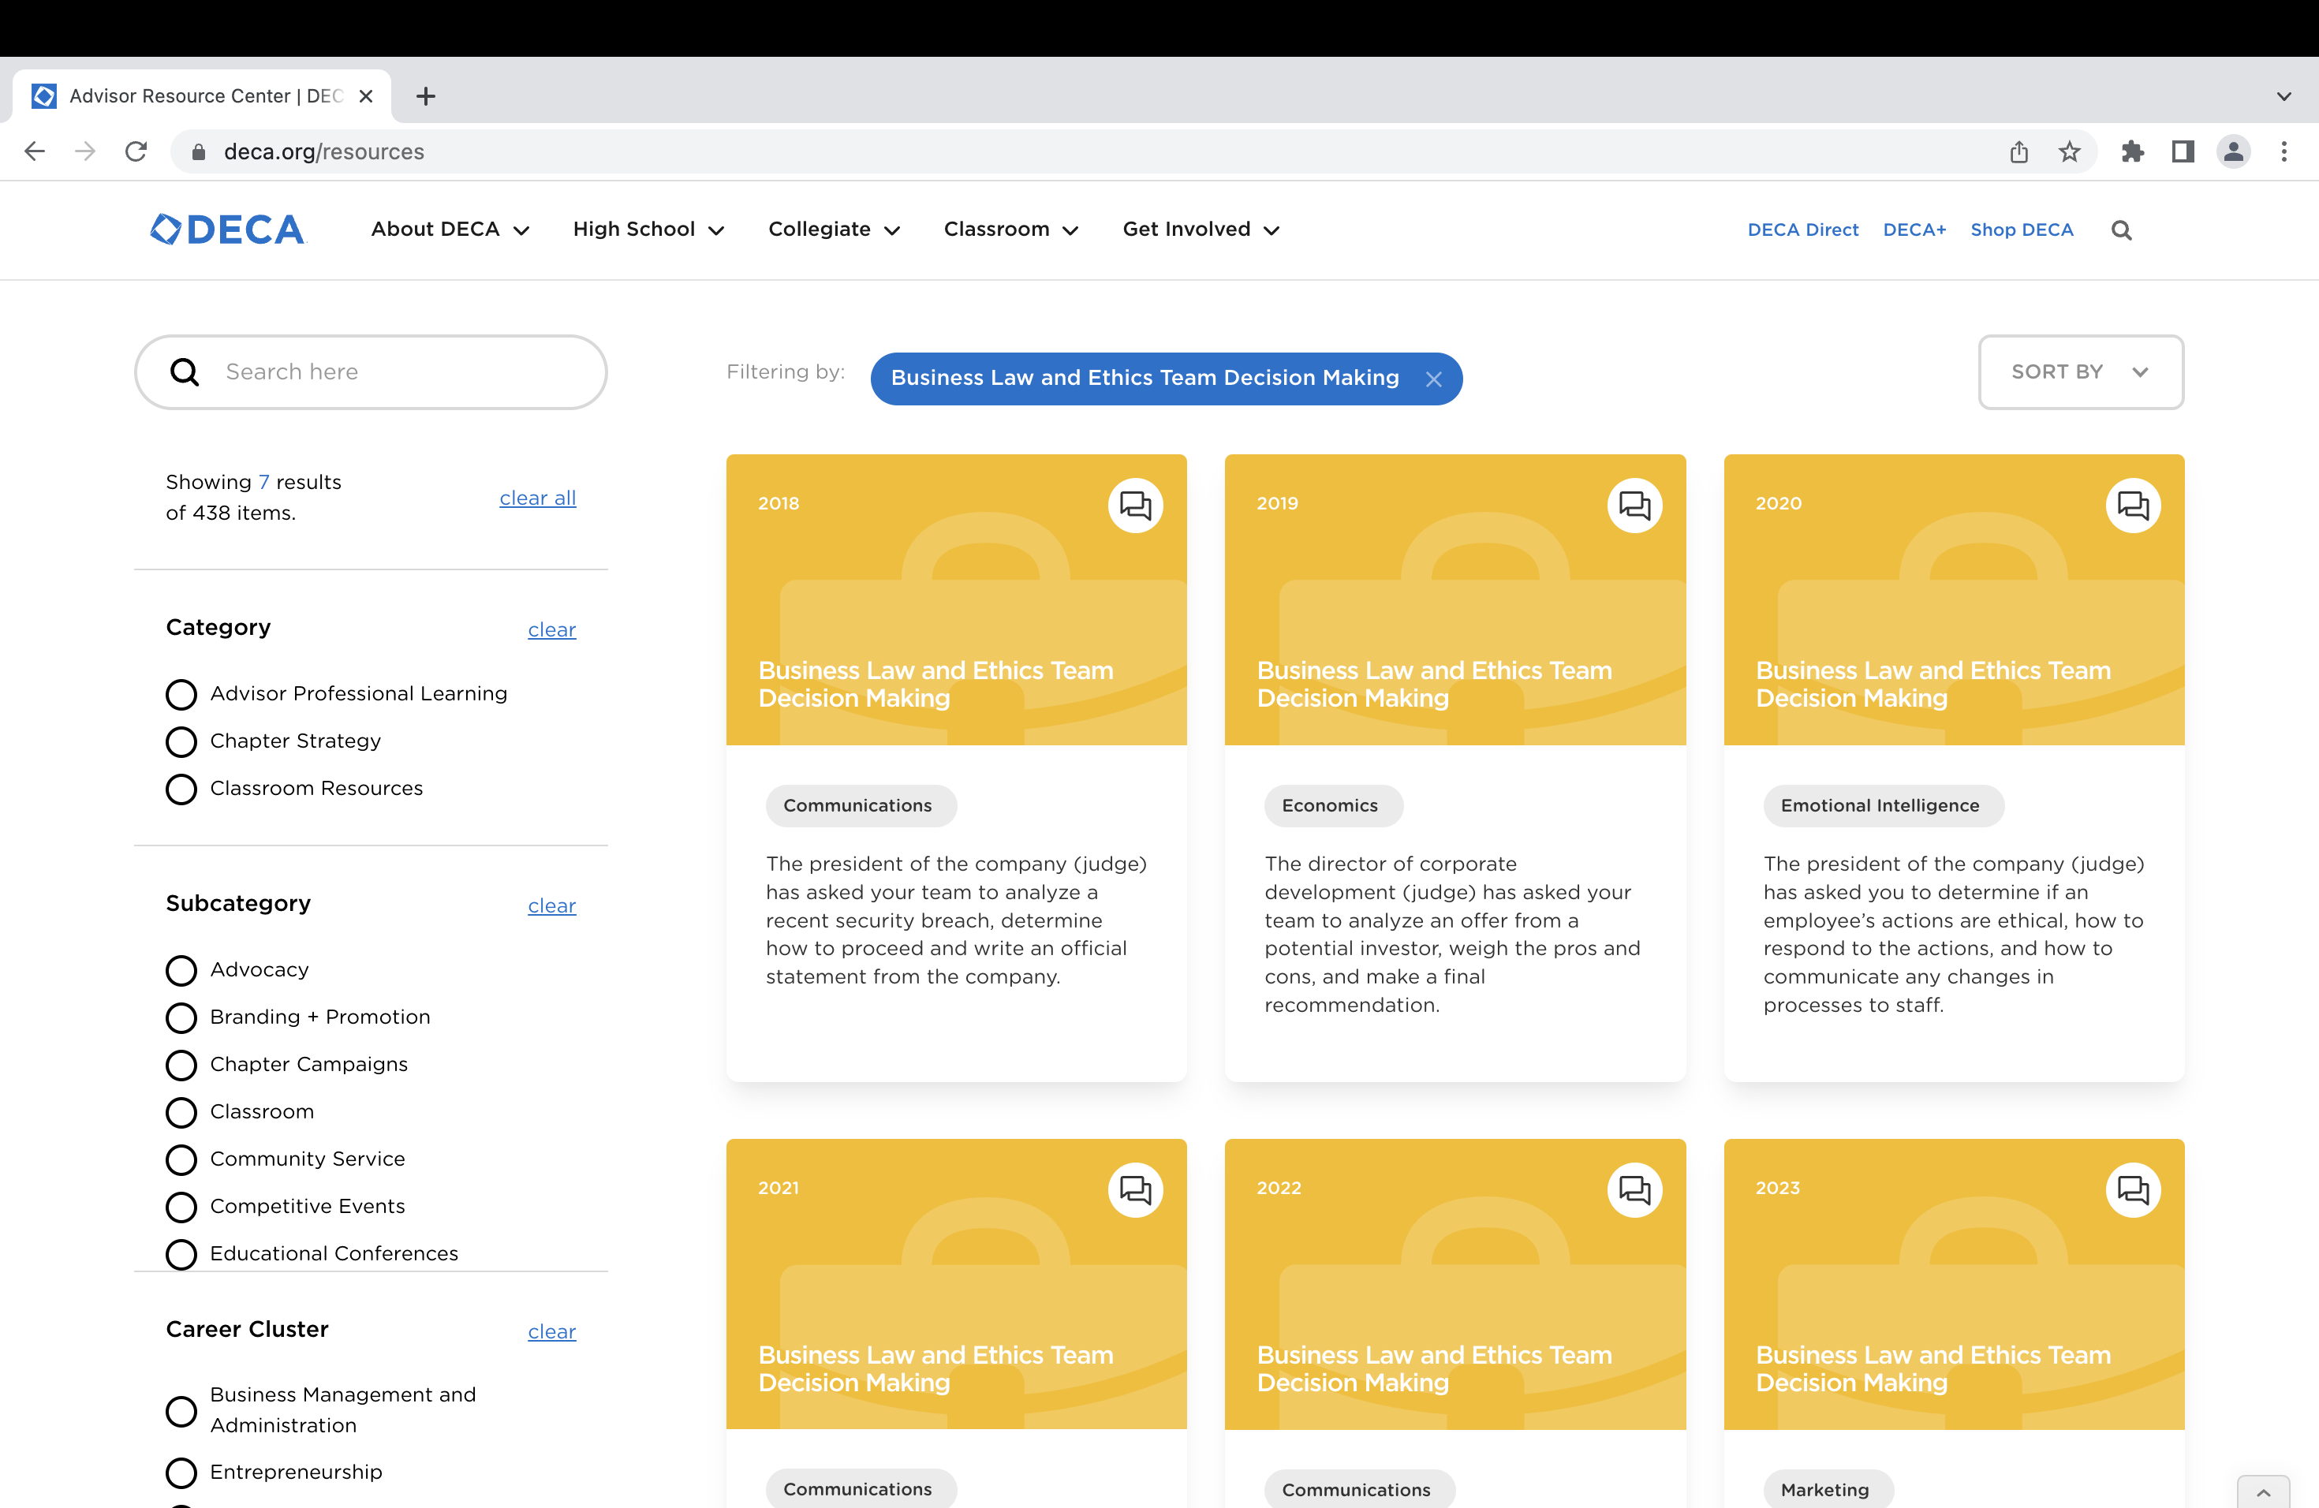

Slide 28
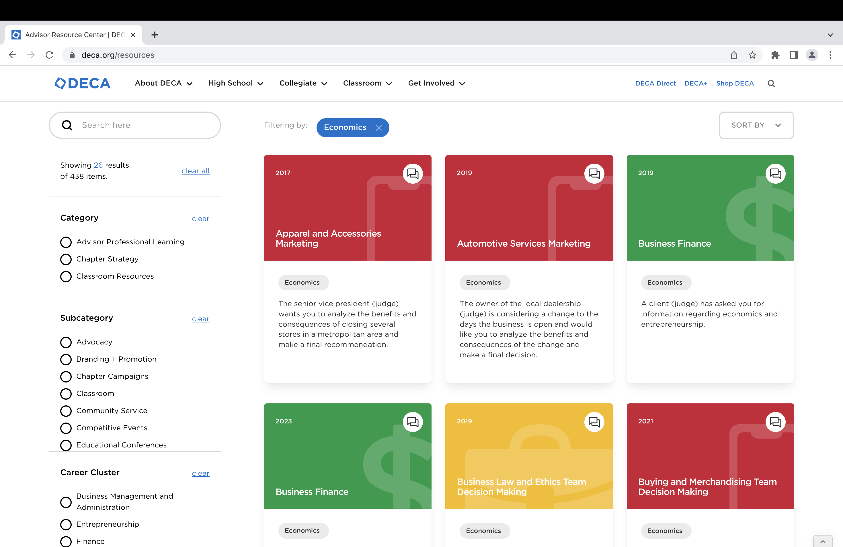

Slide 29
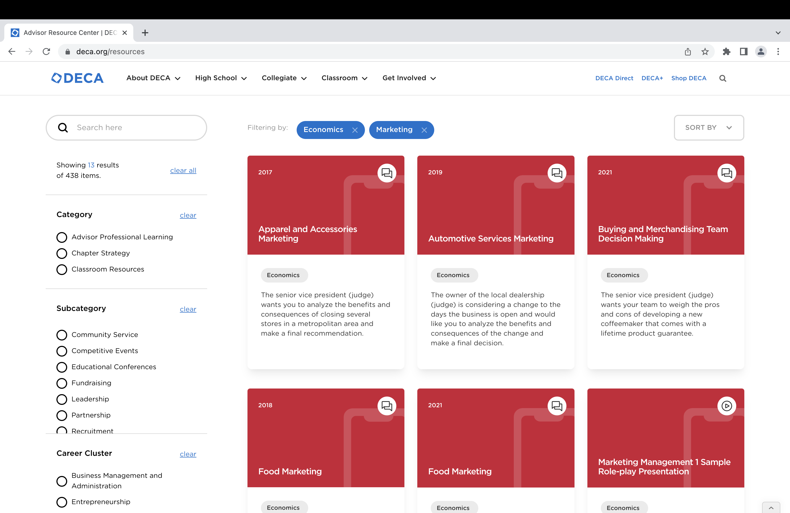

Slide 30
Get in touch
education@deca.org | (703) 860-5000 | www.deca.org

