Slide 1
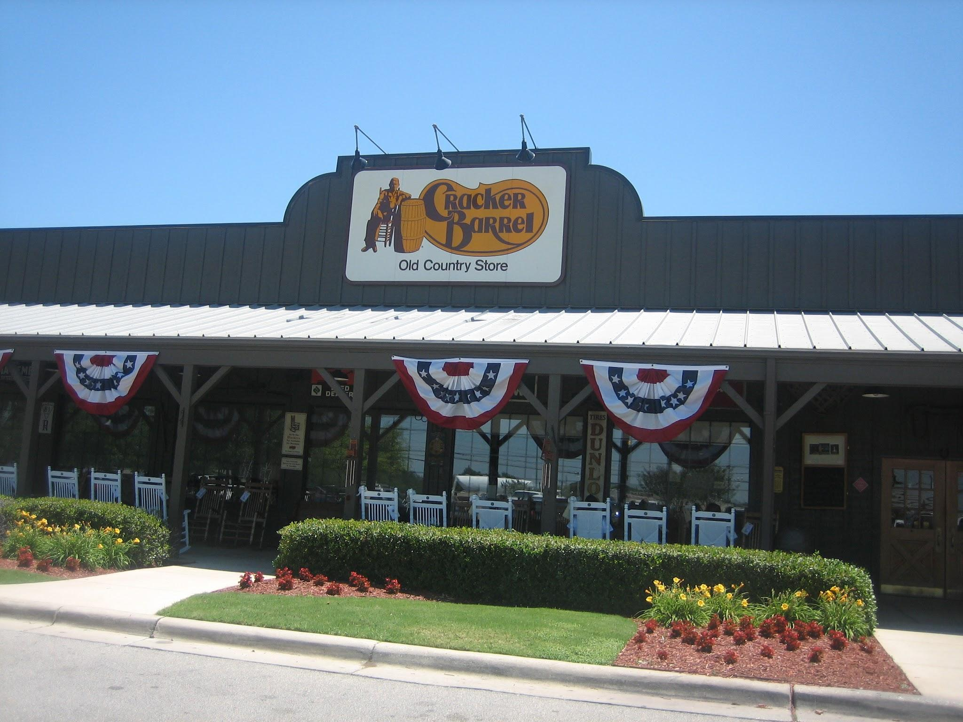
Cracker Barrel’s Rebranding Strategy: Why It Tanked

Slide 2
Bell Ringer
Think of a brand you love. If they completely changed their name, logo, or vibe tomorrow, how would you feel?
Instructions: Write 2–3 sentences in your notebook.

Slide 3
Objectives
Students will understand the importance of brand identity and customer perception.
Students will analyze the Cracker Barrel rebranding attempt and why it failed.
Students will evaluate how customer feedback can impact brand decisions.
Students will develop critical thinking skills through research and opinion writing.

Slide 5
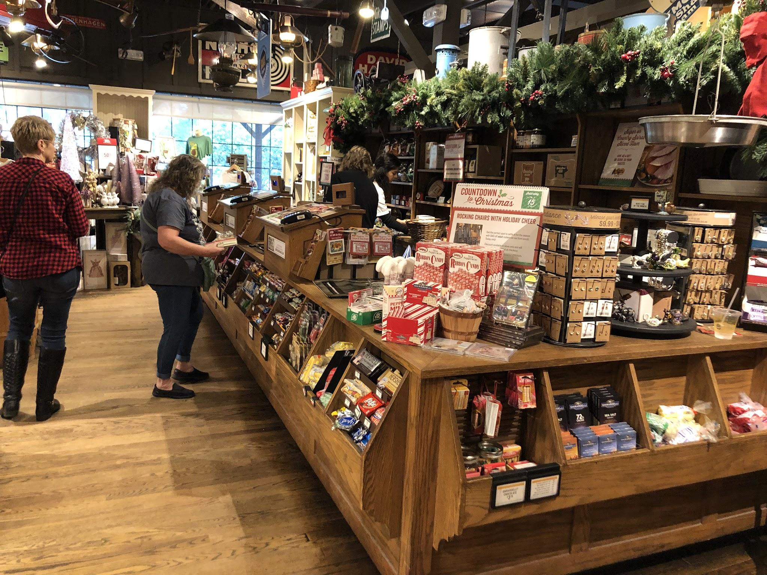

Slide 6
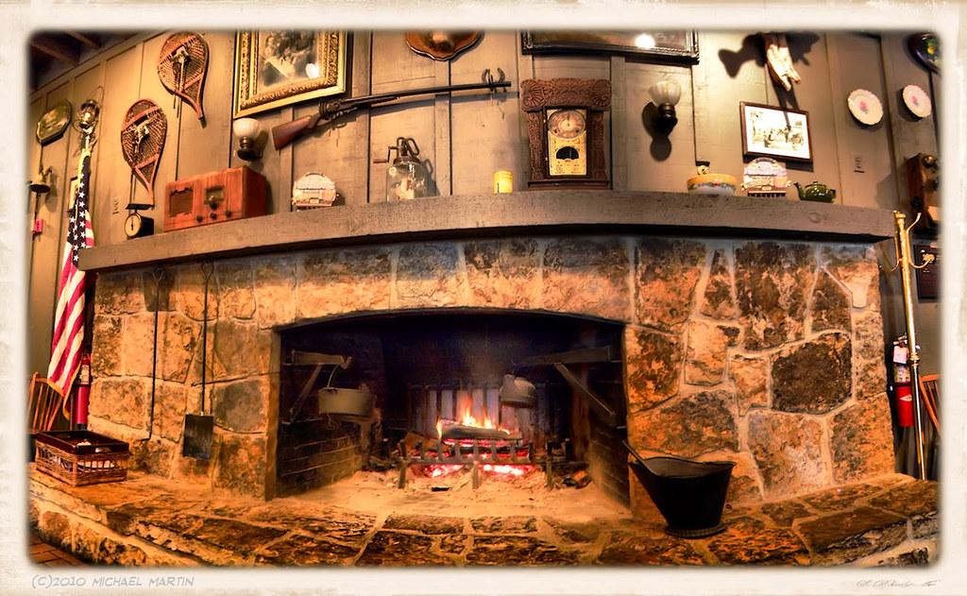

Slide 7
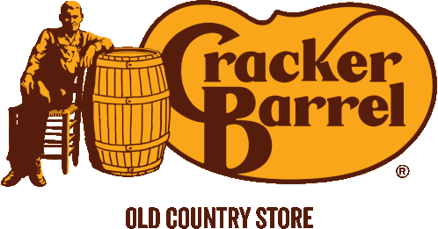
Cracker Barrel’s Identity
Cracker Barrel’s identity: “Old Country Store” feel, southern comfort, nostalgia
Loyal customer base (older, traditional audience)

Slide 8
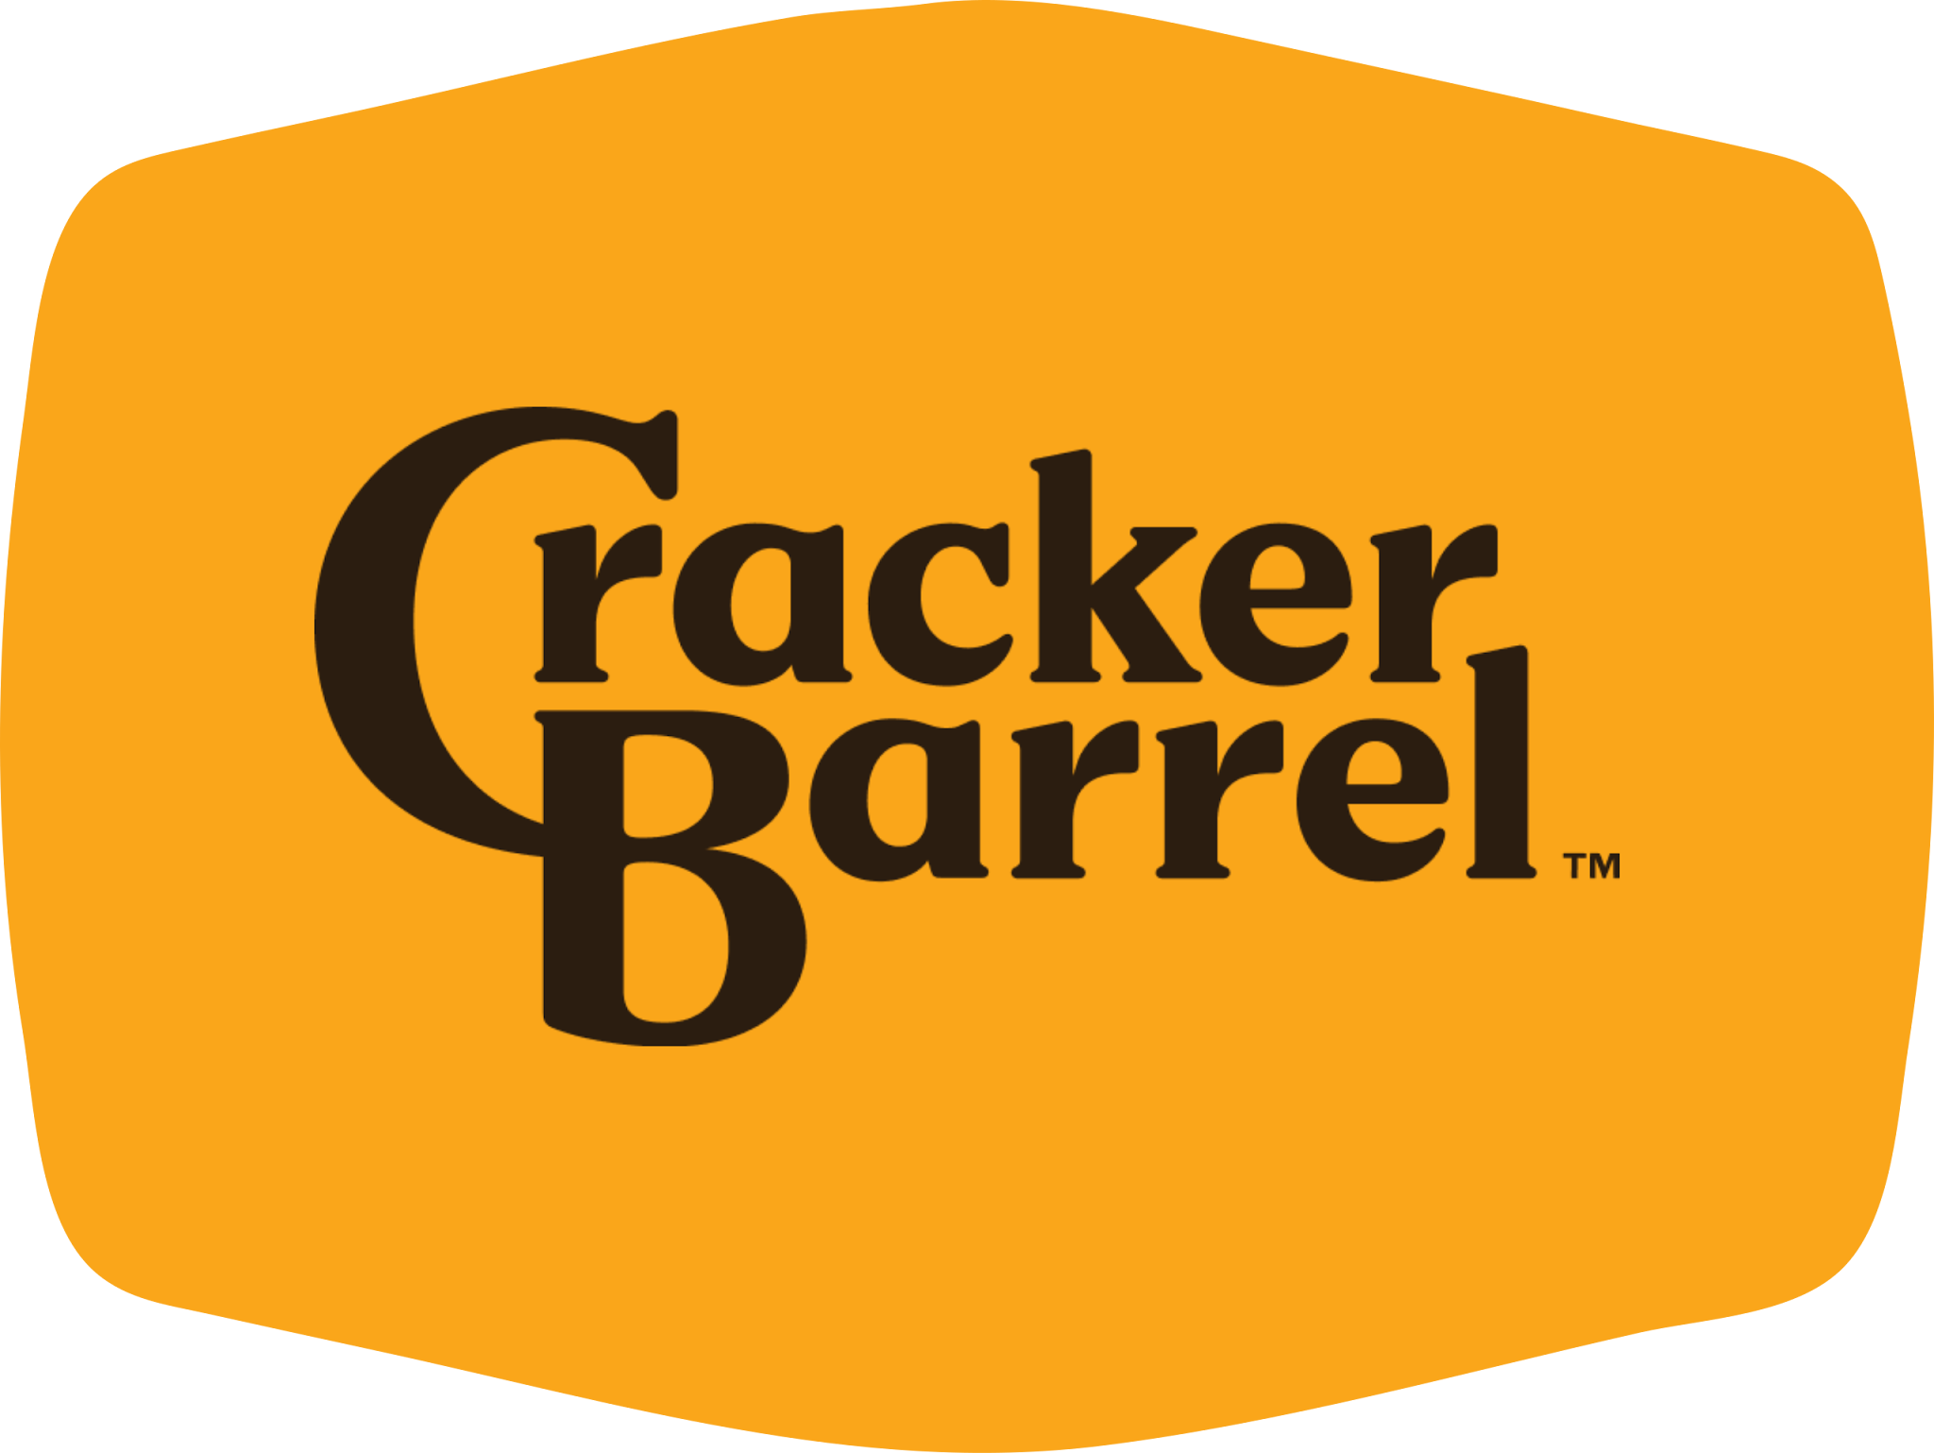
Rebrand
Company’s reasoning: attract younger audiences, appear more modern
Why do you think Cracker Barrel’s rebranding strategy didn’t resonate with customers?

Slide 9
The Backlash
New logo unveiled as part of “All the More” campaign; simplified to just “Cracker Barrel” text without "Old Country Store" or iconic figure AP News+1.
The $700 million effort included updated décor and lighter interiors to attract younger customers The Branding JournalAP News.
Immediate backlash on social media: “generic,” “soulless,” politically charged accusations, and heated customer reactions AP NewsYouGovNew York Post.

Slide 10
The Fallout: Consequences of the Rebrand Misstep
Stock dropped up to 15%, wiping out nearly $100 million in market value CBS NewsNew York Post.
Customer foot traffic and sales dipped noticeably—some locations described as being “dead for a week” New York Post.
Intense political commentary followed—with President Trump calling for a reversal on social media People.comPolitico.

Slide 11
Company Response: Cracker Barrel Reverses the Rebrand
Just days later, the company reinstated the original logo, citing customer feedback and emotional attachment The GuardianThe Washington PostPeople.com.
Experts labeled this a "positive course correction," reinforcing the importance of heritage in brand identity CBS NewsForbesKellogg Insight.
This reversal sparked stock recovery and earned Cracker Barrel goodwill for listening to its loyal base AP NewsPeople.com.

Slide 12
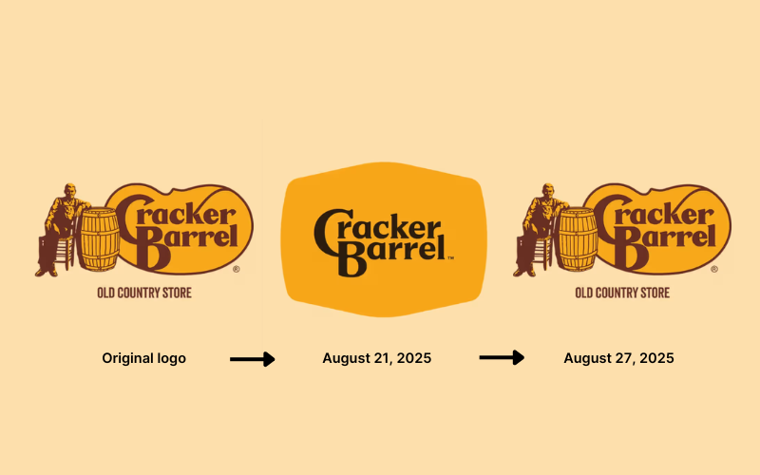

Slide 13
Small Group Research Activity (15 minutes)
In groups of 3–4, research quickly one of the angles below:
Customer feedback on social media
Industry analyst reactions
Comparisons to other failed rebrands (ex: Tropicana, Gap, X/Twitter)
Possible internal company reasons for attempting the change
Each group makes a short 2-3 minute share-out of findings.

Slide 14
Opinion Paper Assignment
Prompt:
Do you think Cracker Barrel should have kept their original brand identity or continued trying to modernize? Defend your answer with at least two examples from today’s discussion/research.
1–2 pages, 12pt font, double-spaced.
Cite at least one real-world customer reaction or business source.

Slide 15
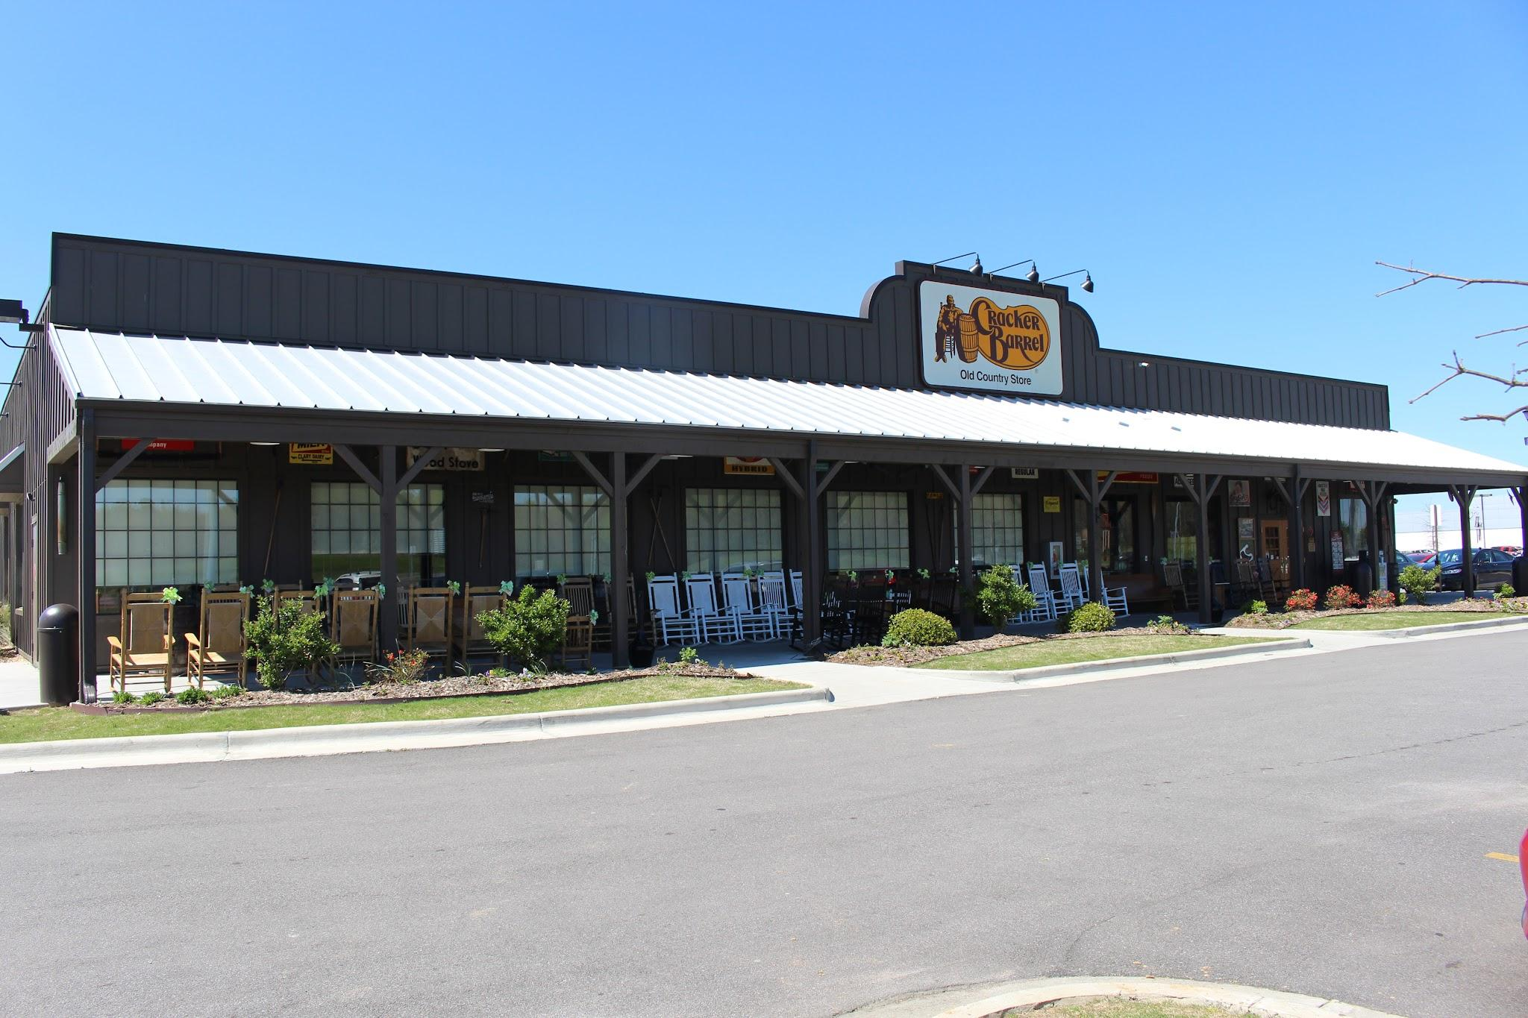
Closing
What lesson can other companies learn from
Cracker Barrel’s rebranding misstep?

